Slide 1
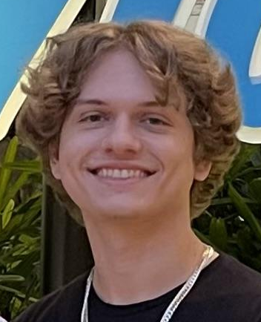
Project E-Bike
UCF College of Engineering and Computer Science
Alexander Gilbert
Carlos Curbelo
Victor Petrillo
Christopher Rumpf
Electrical Engineering
Electrical Engineering
Computer Engineering
Computer Engineering
Notes:
Hello! Welcome to Group 12’s Final Presentation on our project e-bike. In this presentation we will discuss design choices and the final product.

Slide 2



The Team
Alexander Gilbert
Electrical Engineer
Carlos Curbelo
Electrical Engineer
Christopher Rumpf
Computer Engineer
Victor Petrillo
Computer Engineer
Notes:
This is the team, group 12. We consist of two electrical engineers, Alex and Carlos, and two computer engineers, Christopher and Victor.

Slide 3
Motivation and Background
USA’s dominant transportation method is automobiles
Other methods are either:
Inconvenient
Inefficient
Electric bicycles are growing in popularity
Cheaper
Easier to maintain
Strive to contribute to/meet expectations of modern e-bikes
Modern technology
Smartphone connectivity
Notes:
The motivation behind this project is mainly to contribute/meet the current modern expectations of electric bicycles.
Personal cars are a great choice for transportation in the United States
-Most cities/areas in the USA are very spread out and have strong road foundations to allow for gasoline-powered automobiles
-lack foundations for sidewalks occasionally
-This unfortunately renders other transportation methods like walking or traditional bicycles either inconvenient or inefficient
-traditional bicycles can get tiring and can even be considered useless if people are not physically able to bike to their destination
-not the case in heavily urban areas like downtown areas with tightly packed buildings and large sidewalks
These are great supporting facts for why electric bicycles are growing in popularity
-they are a significantly cheaper alternative to cars
-may not require insurance
-certain categories of e-bikes do not require registration
-also incredibly easier and cheaper to maintain than cars
-cars can run up to multiple thousands of dollars to maintain/repair
-e-bikes are significantly cheaper in maintenance cost
With this project, we strive to either contribute to or meet expectations of modern e-bikes
-we are using modern technology to convert a traditional bicycle into an electric bicycle
-includes a smartphone application that connects to bicycle via bluetooth

Slide 4
Goals and Objectives
Engineering Goals | Description
App | Mobile app to control settings and display relevant info.
Throttle Control | Use a throttle to control speed of bike.
Lighting | Lights for night time riding and regulatory compliance.
Stretch Goals
Cruise Control | Set the bike’s speed and not use throttle control.
Assist Mode | Still have to pedal, but long distance or hills easier.
Notes:
Carlos

Slide 5
Project Specifications
Components | spec | Requirement | Actual
Bike | Weight | <= 28kg / 62lbs | 24.75kg
 | Dimension | None | 1.71mx0.67mx1.05m
Battery | Distance/Time | 30km/2hrs | 48km/2hrs
Bluetooth module | Distance | 100m | 100m
App | Bluetooth-controlled | Yes | Yes
 | RGB LED control | App controlled | App controlled
Throttle | Full-twist | Speed control | Speed control
LED | Display | Mode change | Mode change

Slide 6
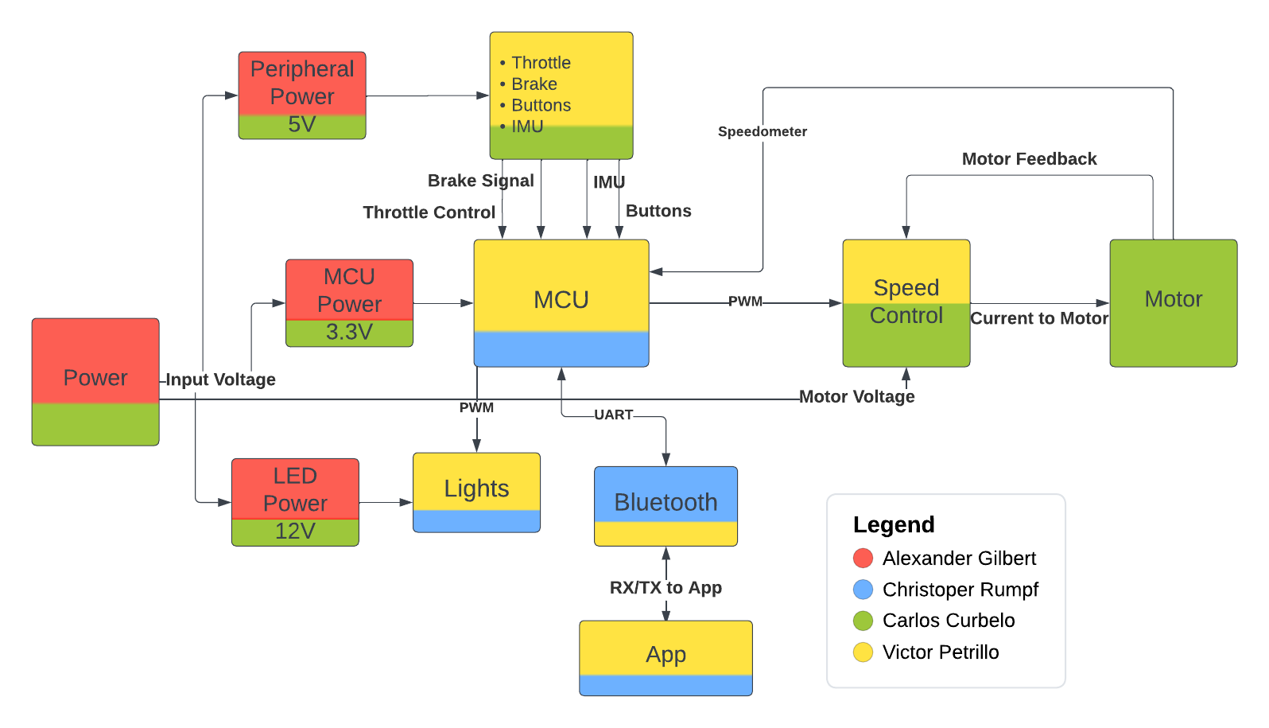
Block Diagram

Slide 7
Comparison and selection of hardware
Motor
MCU
Battery
Bluetooth Module

Slide 8
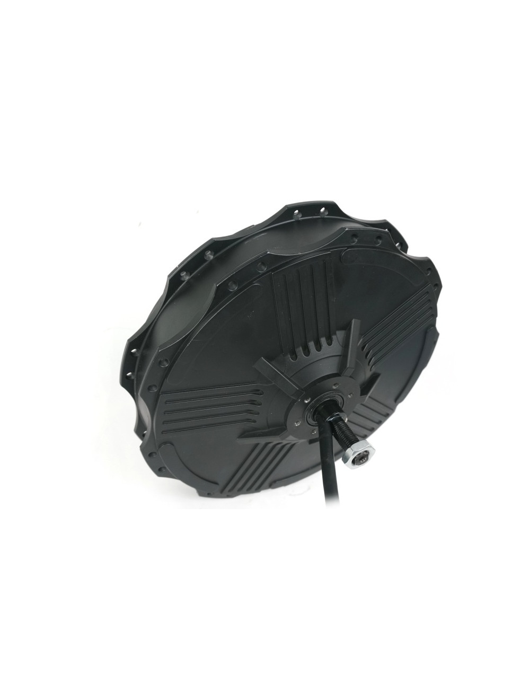
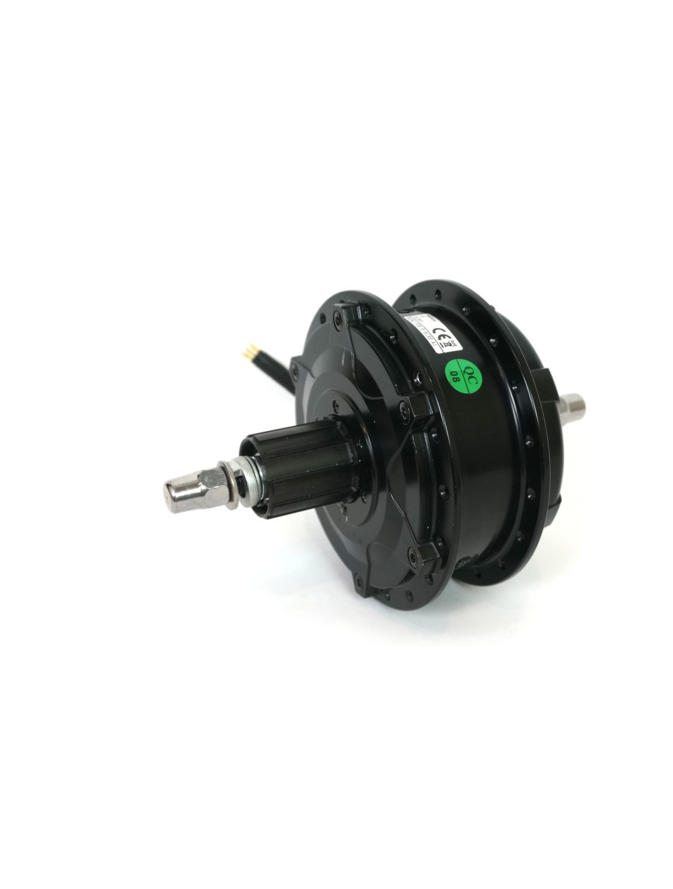
Motor
Bafang G310
RH212
Weight (kg) | 2.55 | 6.58
Power Range (Watts) | 250 - 500 | 600 -1200
Motor KV (RPM/V) | 8.5 | 8.2
Price | 247$ | 260$
Disk Brake Compatible | Yes | Yes
Ideal Winding Size | 24”, 26”, and 700c | 24”

Slide 9
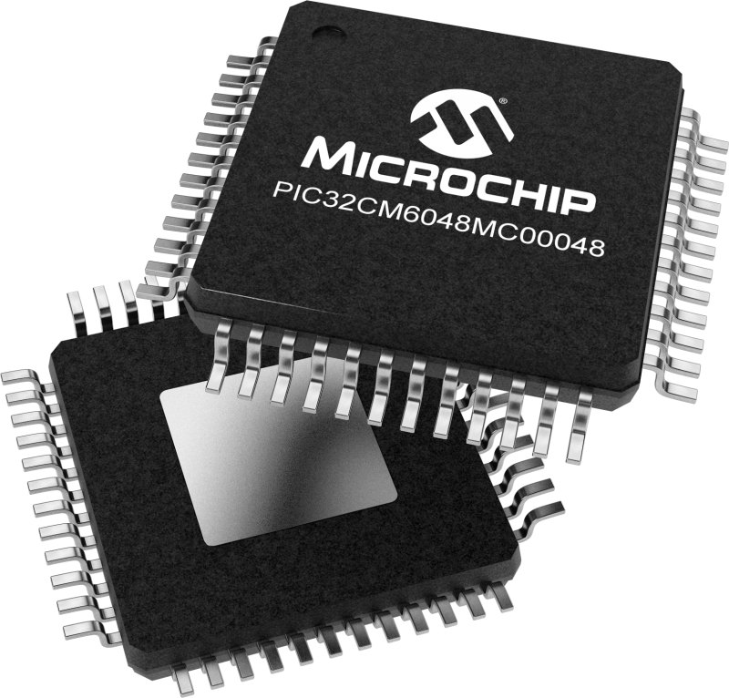
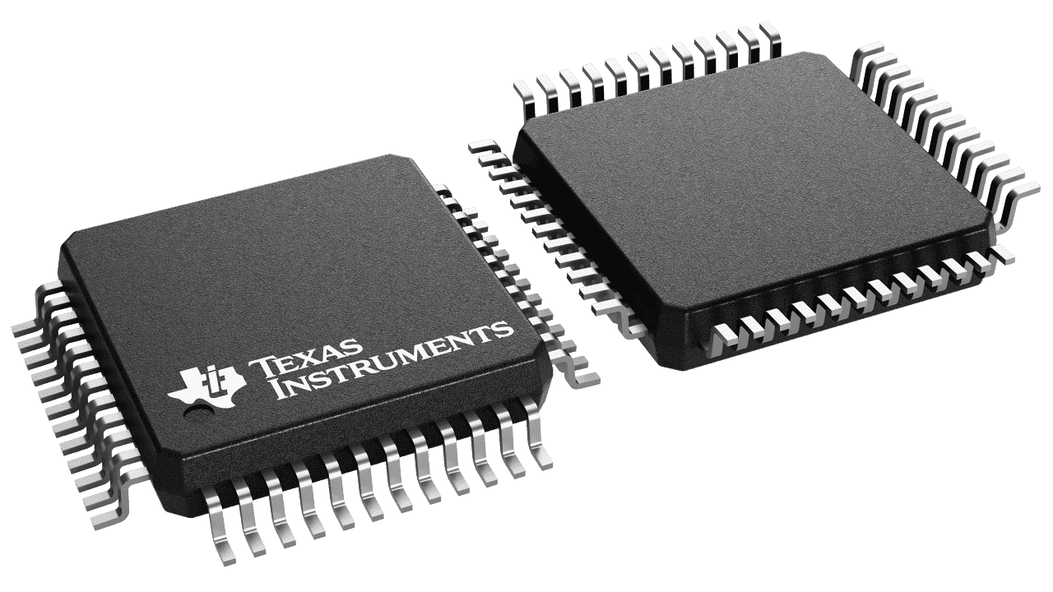
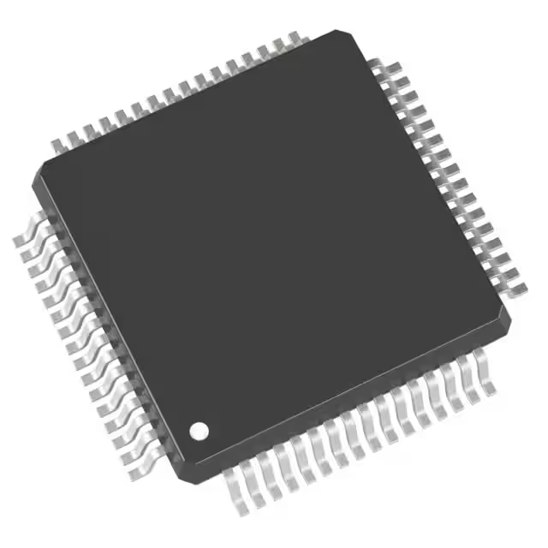
MCU Selection
STM 32
MSP 430
PIC 32
MCU | PIC32CM1216 | STM32F405 | MSP430FR2355
Architecture | ARM Cortex M0+ | ARM Cortex M4 | MSP430 core
Max Word | 32-Bit Single-Core | 32-Bit Single-Core | 16-Bit
I/O Pins | 38 I/O | 51 I/O | 44 I/O
Memory | 128KB Memory | 1MB Memory | 32KB
Operating Voltage | 5V | 3.6V | 3.6V
Max Speed | 48MHz | 168MHz | 24MHz
Program IDE | MPLAB | STM32 Cube | Code Composer Studio

Slide 10
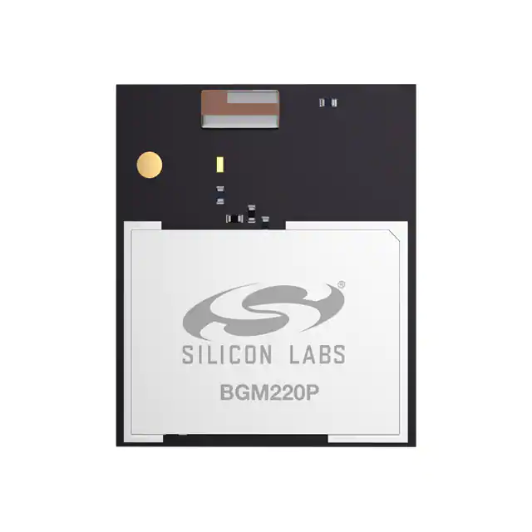
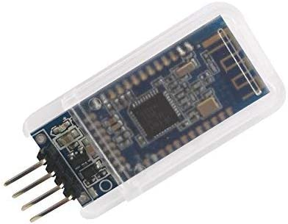
Bluetooth Modules
Bluetooth Module | BGM220 | HM-10
Manufacturer | Silicon labs | DSD technologies
Bluetooth version | 5.2 BLE | 4.0 BLE
Serial interfaces | Multiple (UART, I2C, etc) | UART
Setup | Flash bootloader | No setup required

Slide 11
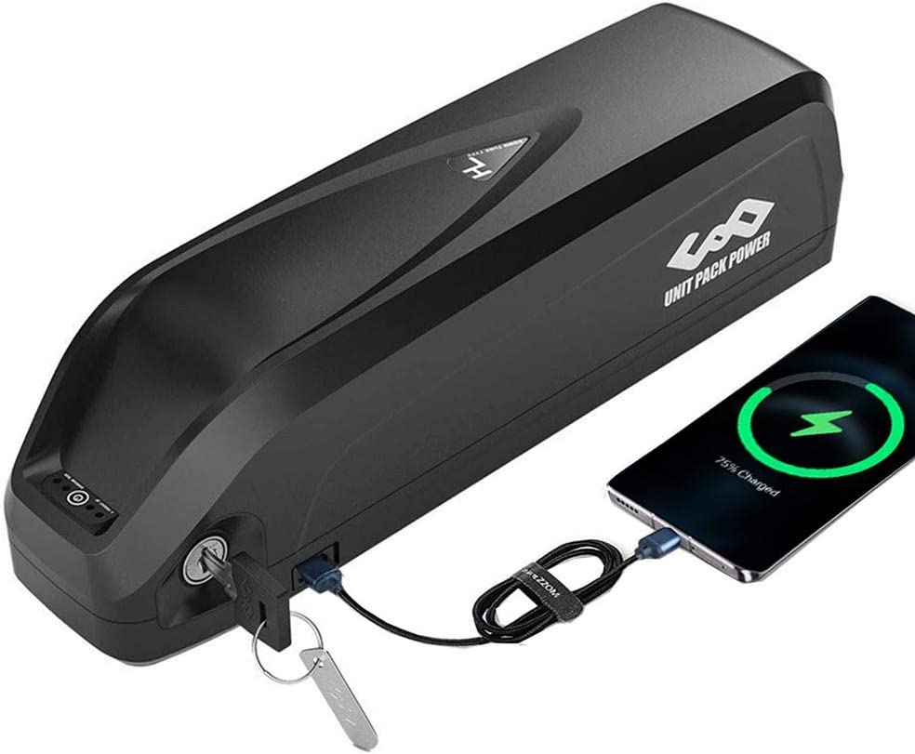
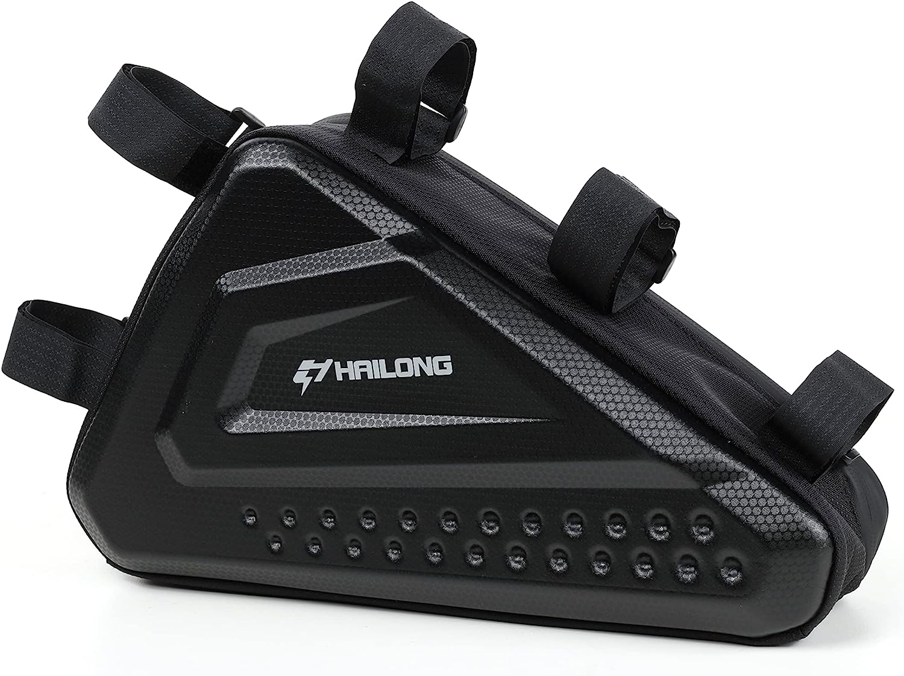
Battery
Battery | Unit pack power | H Hailong
Nominal Voltage | 36 | 36
Max Amperage | 25 | 20
Energy (ah) | 20 | 20
Wattage range | 0-700 | 200-800
Weight (kg) | 4.74 | 4.17
Price | $350 | $270

Slide 12
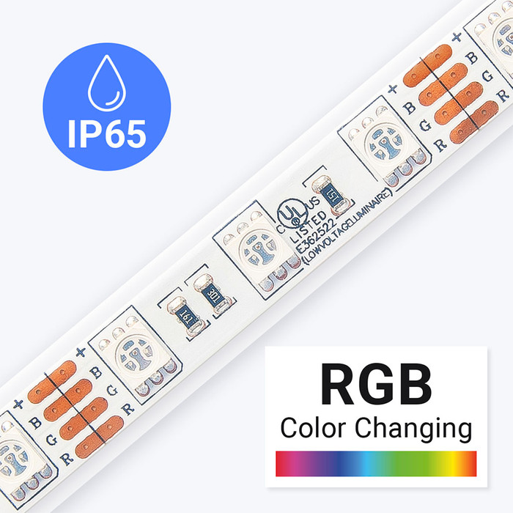
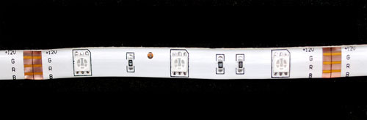
Lights
LED strip | Adafruit product 2485 | Flexfire LEDs
Voltage range | 9-12 v | 12v
Current draw | 0.5 A/m | 1.2 A/m
Power draw | 6 W/m | 14.4 W/m
PWM control | Yes | Yes
Water proof | Yes | Yes
Adhesives | Yes | Yes
Cutting points | 100mm | 50mm

Slide 13
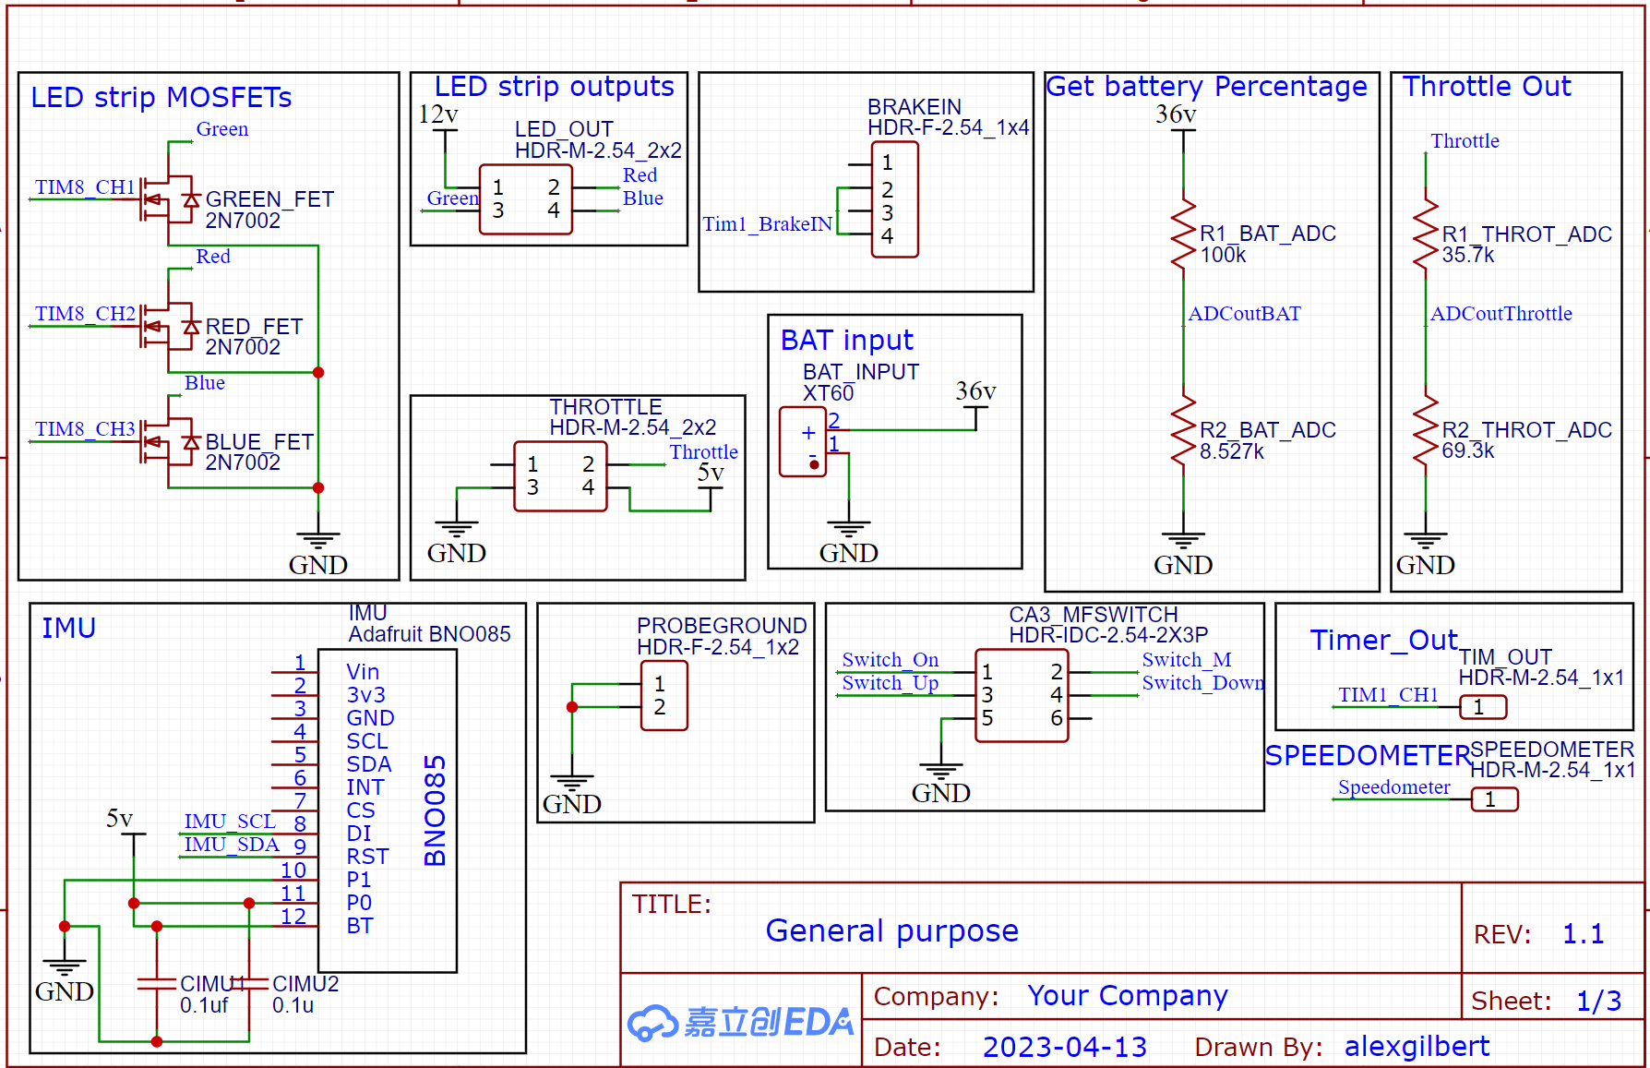
PCB Schematic
Input/Outputs

Slide 14
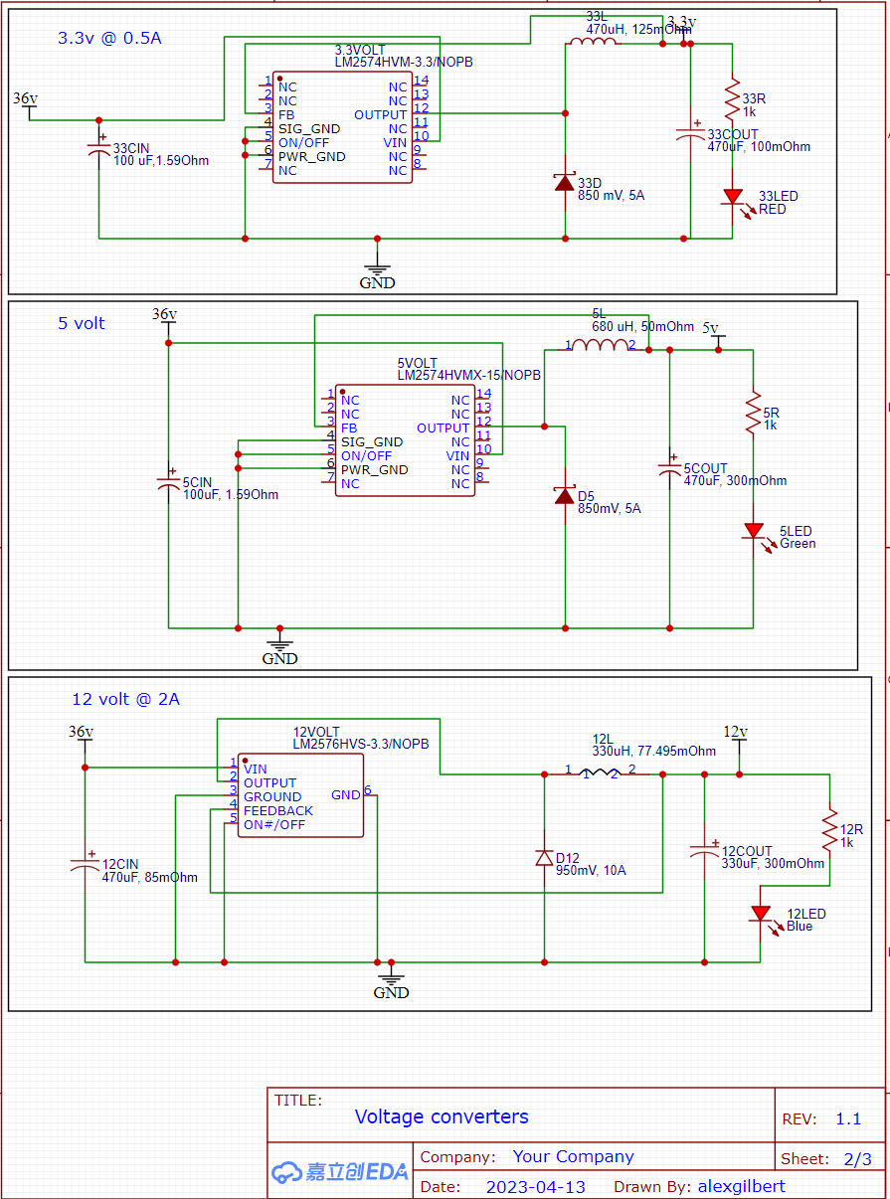
PCB Schematic
Need four voltages

Slide 15
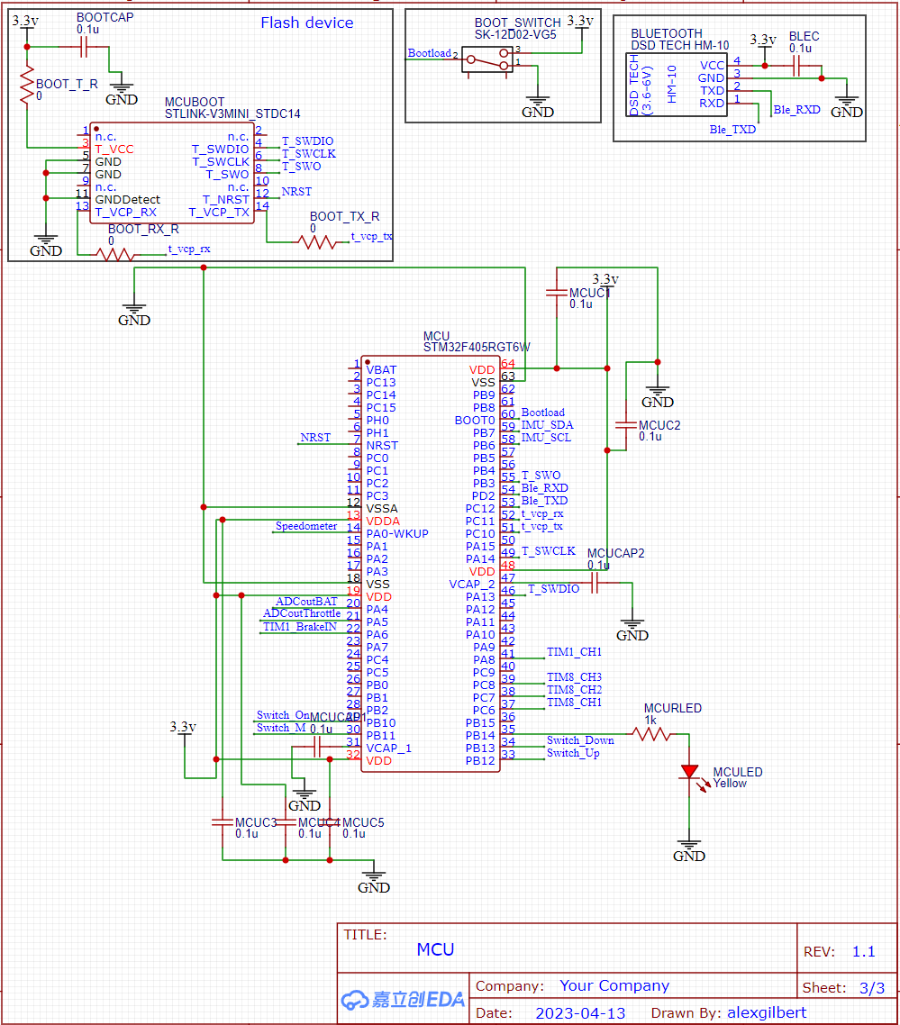
PCB Schematic
MCU and Bluetooth
Notes:
Here we see the MCU with the Bluetooth and flash device. There is also a physical button on the PCB to allow a reset of the MCU.

Slide 16
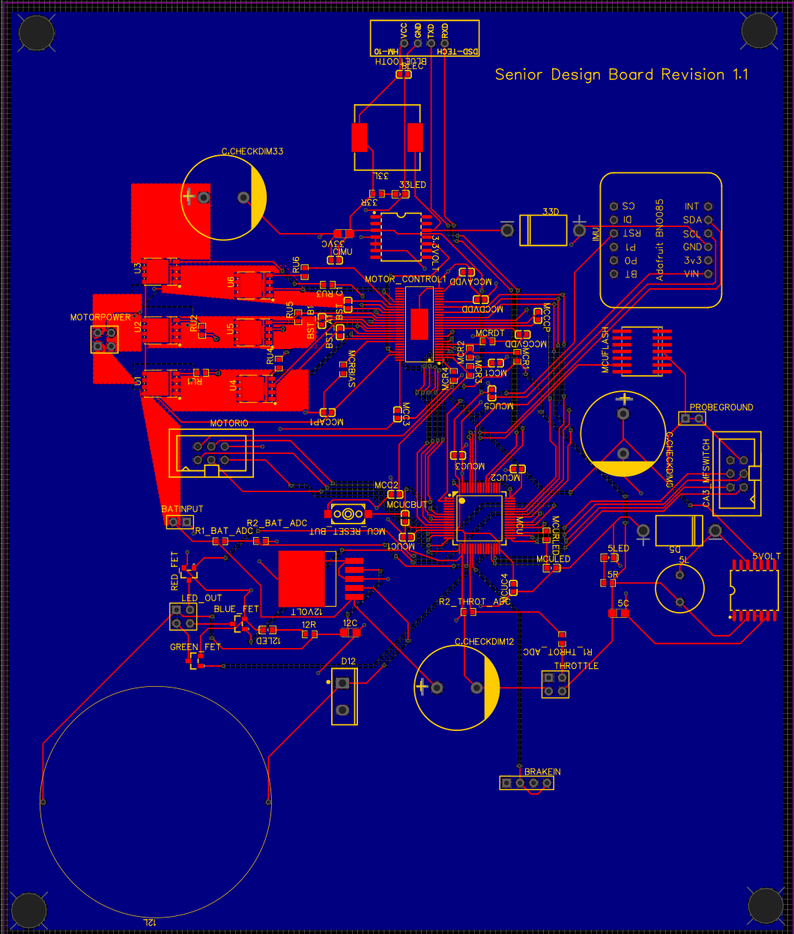
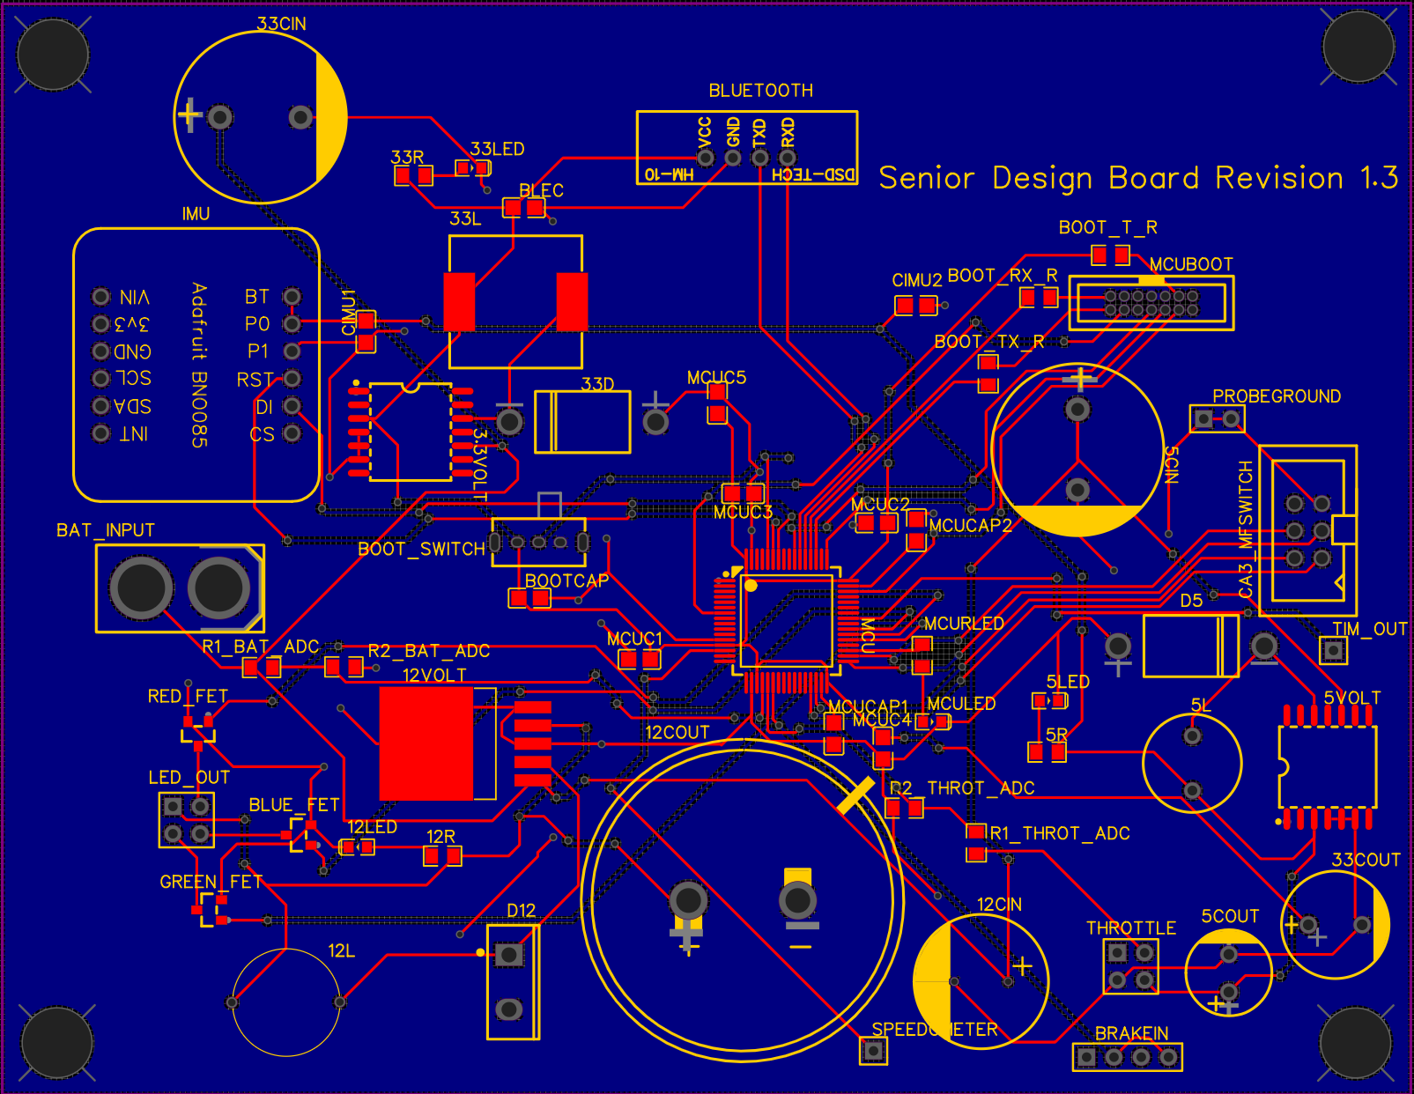
PCB layout 1 and final
175.6mm by 148.7 mm
101.4 by 131 mm
Notes:
This is the first iteration of the PCB that we have developed with a size of 175.6 mm by 148.7 mm. We used PCBway as the manufacturer because of the price and the speed of manufacturing and delivery, taking around 3 business days for this iteration. For future iterations of the design, the inductor size is too large for the footprint so the size can be brought down and there are not enough lanes to flash the MCU while soldered to the PCB. I’m sure other problems will appear as we test the parts being put onto the board. When testing the board, we will do it one part at a time such as with the MCU to ensure the connections are correct with the Bluetooth, for example.
Here is the final iteration of the PCB which is smaller at 134 by 130 mm with the updates to the problems stated earlier.

Slide 17
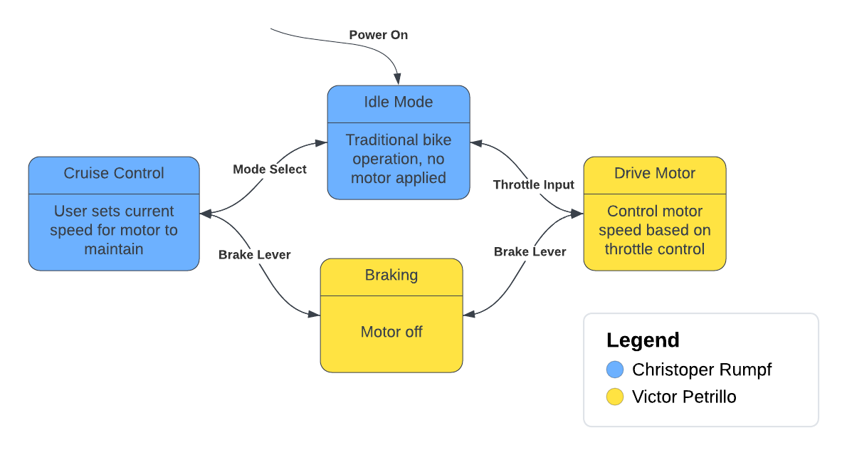
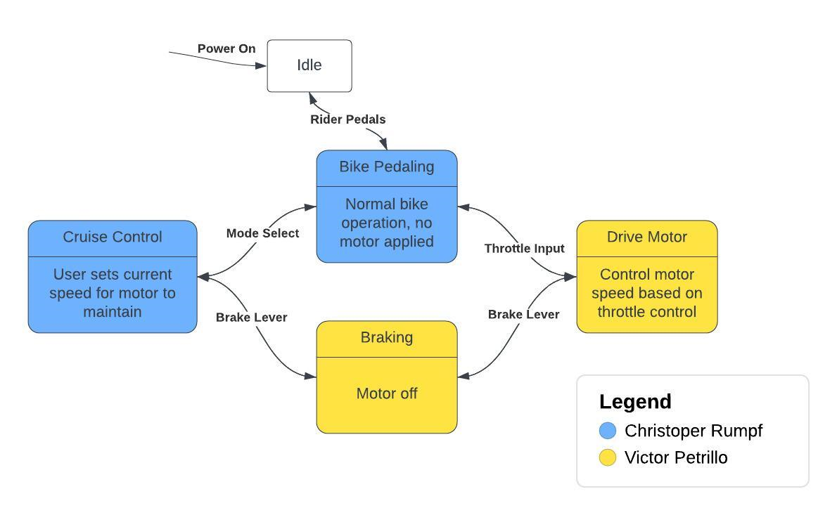
Software State Diagram

Slide 18
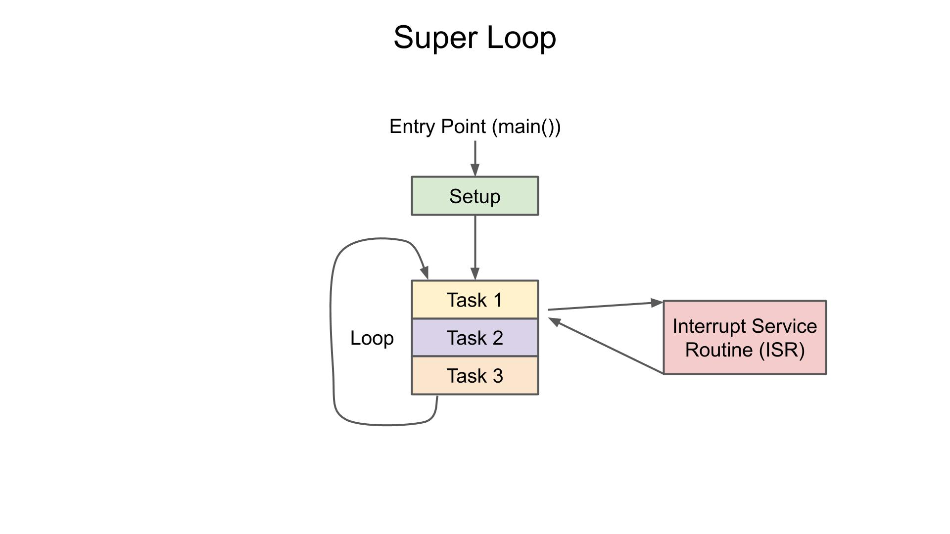
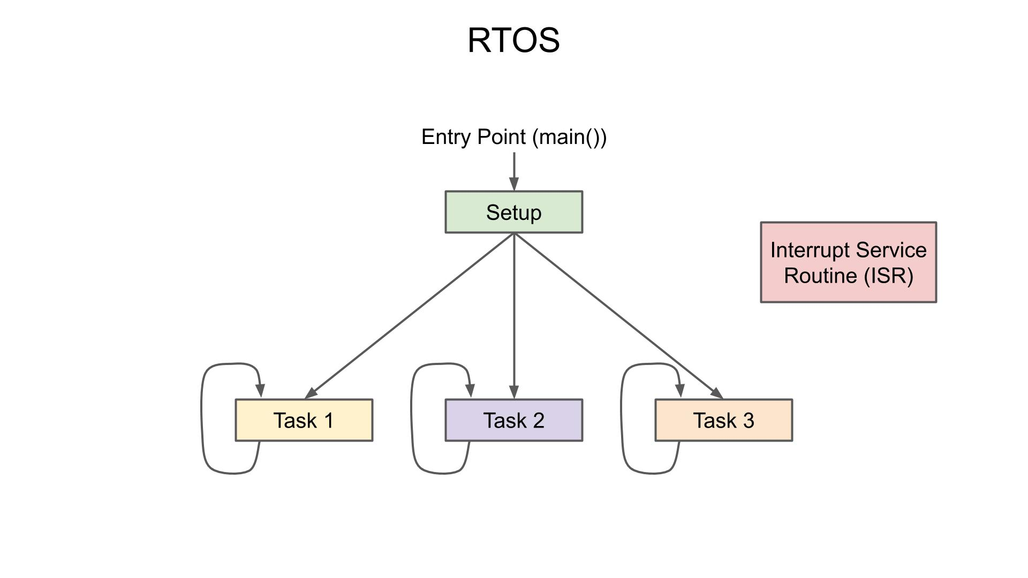
MCU Programming Structure
Image source digikey article: what is a realtime operating system rtos

Slide 19
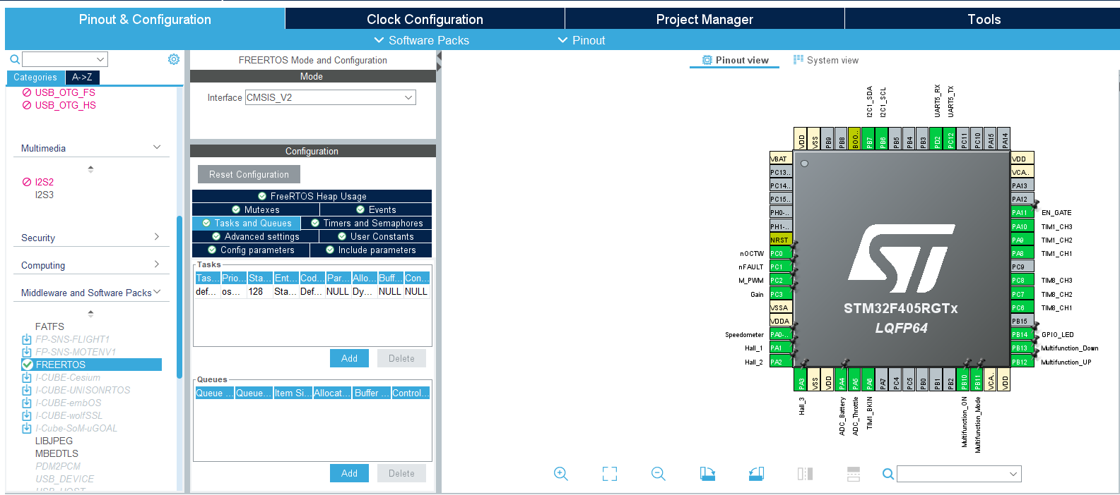
MCU Configuration

Slide 20
Tasks
Motor Control - Realtime
osPriorityRealtime
osPriorityHigh
osPriorityAboveNormal
osPriorityNormal
osPriorityBelowNormal
osPriorityLow
Bluetooth Comm. - High
IMU & Battery - AboveNormal
LED Lights - Normal
Motor Speed - ISR

Slide 21
Bluetooth Packet - Transmit MCU to App
Key value pairs, in a comma separated string
Multiple packets with max of 20 bytes each
Format
“battery: voltage (%), speed: time between pulses (ms)”
“throttle: adc output (12-bit), mode: current mode (0 or 1)”
Ex:
“battery: 100, speed: 75”
“throttle: 4095, mode: 1”

Slide 22
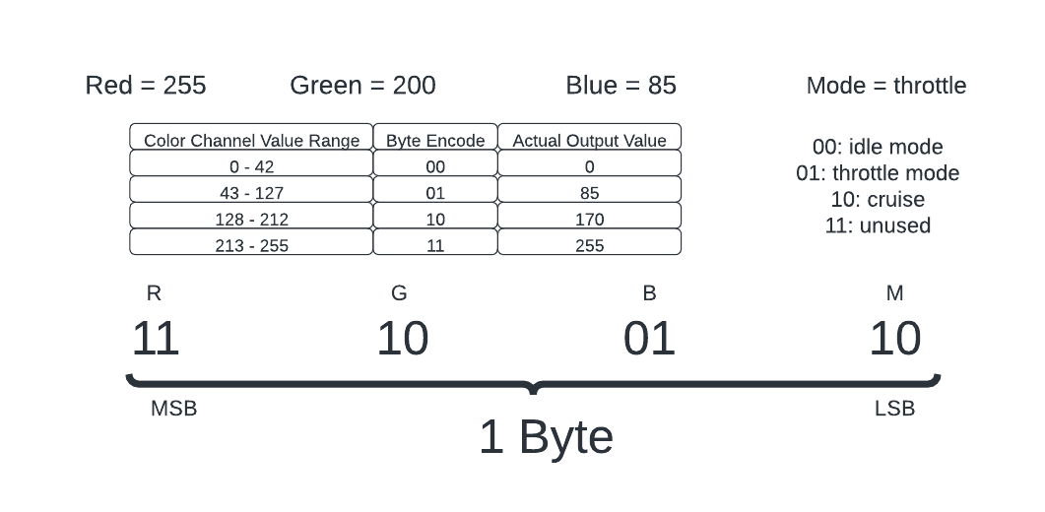
Bluetooth Packet - Receive App to MCU
Data transmitted from app to MCU is done in a single byte
Used our own byte encoding for the project’s purposes

Slide 23
Application Development Approach
Technology selection was ease-of-use driven
Both developer and user experience
 | Web Application | Smartphone Application
Pros | Accessible on any device (if desired) Great documentation on available technology Cross-platform | Downloaded to device No network connection required Also (potentially) cross-platform
Cons | Requires server hosting Requires network connection Not developed specifically for smartphone | Relatively newer tech to web apps Potentially less documentation
Notes:
The application’s technology had to be selected before designing or developing could begin.
Two approaches to development were considered: a web application and a smartphone application. While both approaches presented their own arguments for why it should be taken, all points must be considered; including a smooth development process as well as ease-of-access.
The web application approach would provide ease-of-access to the user by allowing it to be accessible on any device. This would not only means any internet-capable device could take advantage of the application, but also implies cross-platform capabilities. However, since this is a web application, it would require server hosting which prove not only tricky to accomplish, but also potentially introduce more cost into the project, since third-party hosting websites tend to charge users for hosting capabilities.
The smartphone application approach would provide not only ease-of-access to the user, but also could prove to smoothen the development process. This approach would eliminate the need for server hosting, since the application would be downloaded to the user’s device. Although, smartphone applications are relatively newer technology compared to websites, and this can prove to provide less documentation/community support for issues that may arise.

Slide 24
Application Technology Selection
 | iOS (XCode, Swift) | Android (Android Studio, Java/Kotlin) | Flutter (Dart)
Pros | Most group members have iPhones Easy to work with Apple’s support | Runs natively on both Windows and MacOS Great community support | Is cross-platform Enables every member to test Great documentation (Google developed)
Cons | Does not run natively on Windows | One Android phone in group; limits testing Kotlin an unfamiliar language | Dart is a new language to both community a the group Steep learning curve
Flutter was selected to support application development
No data collection, no database
Notes:
After deliberation over the technology approach, the smartphone application was selected as the approach that supports the group’s requirements, greater so than the website application.
With smartphone application development, a main technology needs to be selected in order to drive development. With a smartphone application, there are a few different choices.
iOS
-apple is big company and has great support and documentation
Android
-android is open source and much more community friendly
Flutter
-although a steep learning curve, it would prove the most useful due to (reasons on slide)

Slide 25
Flutter Libraries
Development was assisted by libraries
A select couple mentioned below are the most vital to the app:
Flutter_reactive_ble (v5.0.3)
Provides a framework for the application to communicate via Bluetooth Low Energy
App_settings (v4.2.0)
Includes a pathway to link user directly to their device’s settings
Location_permissions (v4.0.0)
Allows the developer to ask the user for necessary privacy permissions
Notes:
Mention how since the bluetooth module we ended up using was ble, we needed a ble library and not something outdated like bluetooth 4.0
Mention that even though the permission for bluetooth is asked for and the connection with the bike is established all within the app, the device’s settings might still require tweaking for bluetooth to function properly (i.e. bluetooth somehow malfunctions and requires a functional reset in order to regain functionality)
With iOS devices, permission must be granted to the application by the user in order to utilize bluetooth technology on the device, the location permissions library enables the developer to ask the user for permission to use the technologies on the device (not just location services like the name might imply)

Slide 26
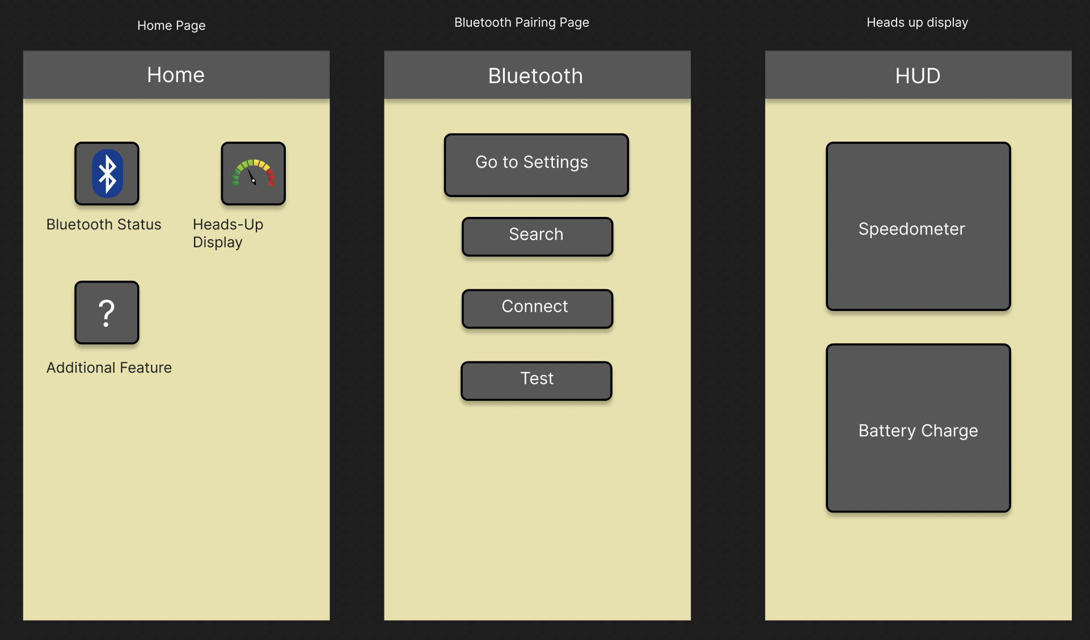
Initial Application Design
To design application prototype, figma.com was utilized
Layered diagrams
Focus on certain keywords when designing:
Simple
Understandable
Informative
Notes:
Figma.com is a great site that, for free, allowed the group to create a skeleton prototype design of the application itself
Mention that how ease of access and simple visuals were key factors when deciding what technology to use, and that mentality extends into the application design as well.
NO MORE MODULARITY, DONT SAY THAT
Also, as a tid bit, mention the color scheme and how its not only a good combination of colors, they also contrast well with another to increase accessibility and legibility. Also maybe mention it’s only appropriate for the school we all attend, UCF

Slide 27
Application Design Alterations
Some initial design aspects of the app were altered
Some changes logical, others to streamline development
Multiple pages combined
Light control and mode selection were planned as separate pages
Combined into HUD page to make operation simpler
Removed modularity, opted for linear experience
The page combining removed necessity for home page
Passing BT device data between pages was time consuming to execute
A linear passing of data (from BT page to HUD page) proved much easier
Notes:
Although the application had a initial design the group wanted to achieve, the reality was that it was a little ambitious.
Some design choices were altered or even completely removed to not only save time on development, but to also make the user experience more logical.
Having a home page with buttons that lead to different screens that had different functions was a great idea, as it provided an extreme amount of overhead for feature additions in the future, if necessary.
It was, however, unnecessary for there to be a separate page for each little feature the application had. Out of the executed features, there were just enough to fit comfortably on the heads-up-display without compromising legibility or simplicity.
So, these features were incorporated into the heads-up-display page, giving the user more direct access to the features rather than having to change pages.
This proved to be a beneficial change not only for the user but also for development. Removing the need for a home page with multiple different pages also removed the need for Bluetooth device data to be passed between each page, back and forth,
constantly.
Instead of the modular home page, a linear experience was opted for; starting from the landing warning page, straight into Bluetooth connection, and, after a connection with the e-bike is established, can provide access to the new, combined heads-up-display.

Slide 28
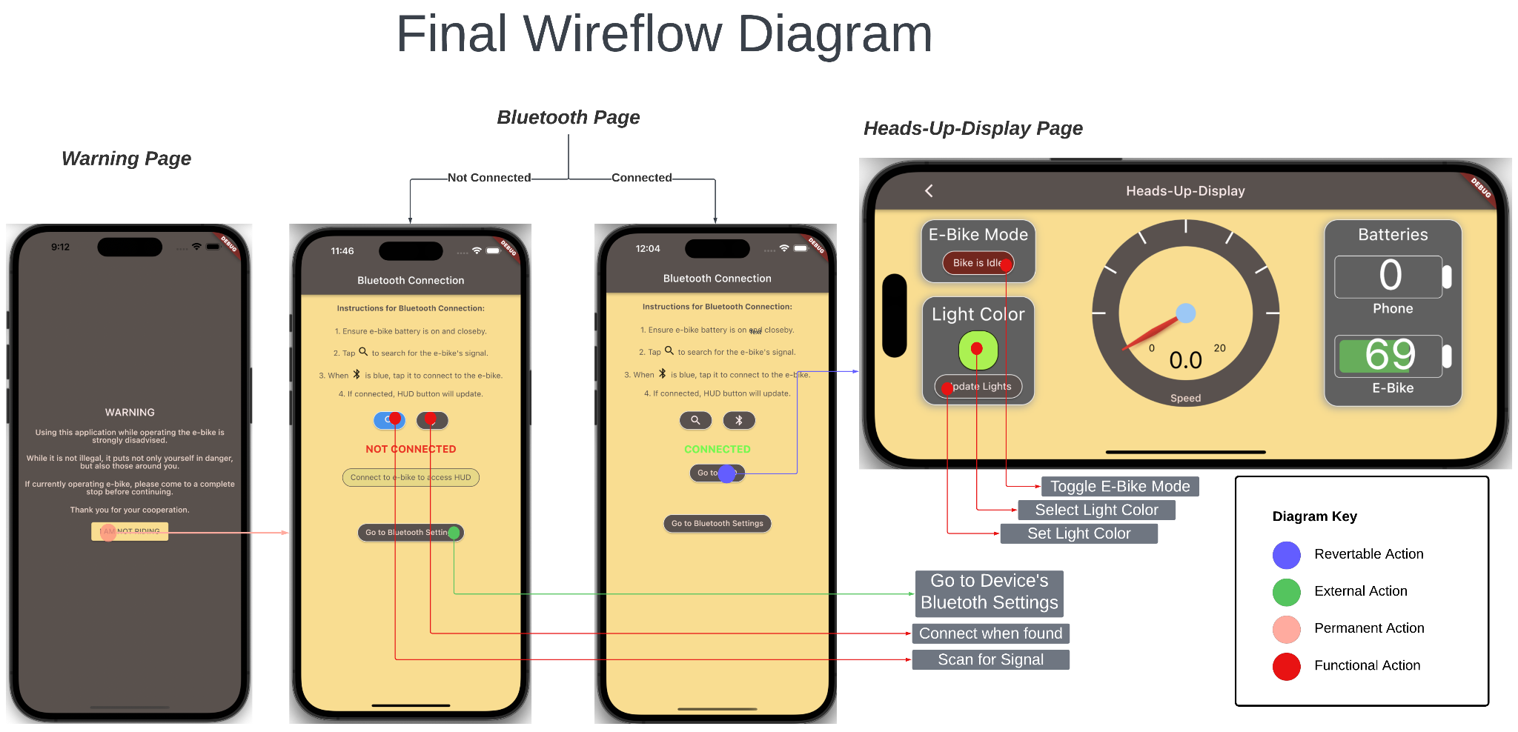
Final Flowchart
Notes:
Here is flowchart of app
Actions are separated into categories in terms of where it takes you (point out diagram key and the colors)
Begins with warning page (plz read)
Leads into Bluetooth page
Explain features on bluetooth page
Bluetooth page takes you to hud page when connection is established
Explain features of hud page

Slide 29
Final State of Application
Application is fully functional
Pages are built and function as intended
Navigation between pages is smooth and intuitive
Heads-up-display page functions as expected
A two-way Bluetooth link has been established, tx and rx
The biggest hurdle for the app
Stretch Goals
Cruise control
Overhead included, but time constraints prevented from being reached
Android platform mostly functional
Compiled for both platforms, both can establish Bluetooth link
Notes:
The application has reached its final stage and is fully functional. The pages are built and the navigation through the app is as fluid and intuitive as expected, and the hud and bluetooth pages have been touched up to provide a more user-friendly experience.
The heads up display now functions fully as intended, with a complete, two-way bluetooth connection capable of transmitting and receiving data. It is capable of transmitting a e-bike mode toggle and a user-selected LED color, as well as receiving speed and battery charge updates. Whenever a change is made, either by the user via mode or lights or by the e-bike via speed or battery, the screen is automatically updated to display the correct information.
The application has been finished with the planned features in a timely manner in time for this final presentation. Unfortunately, the stretch goals we initially proposed were not able to come to fruition. Enough overhead was planned and implemented to allow for a cruise control feature, however we were not able to implement this due to time constraints.
Flutter was chosen to be a cross platform development environment. The application can be compiled and launched on both iOS and Android devices, and both can establish a two-way Bluetooth link with the e-bike. The Android side of the app is almost fully functional, still requiring some polishing.

Slide 30
Administrative Content
Budget
Work Distribution

Slide 31
Cost
Item | Estimated Price
Motor (1 unit) | $240
PCB (3 – 5 units) | $180
Lithium-ion Battery (1 unit) | $350
Sensors/peripherals | $276
Circuit components | $100
Forecasted Total | $1146

Slide 32
Work distribution
Name | PCB design | App developer | MCU Software | Hardware assembly & Testing
Alex | Primary |  |  | Secondary
Carlos | Secondary |  |  | Primary
Chris |  | Primary | Secondary
Victor |  | Secondary | Primary

Slide 33
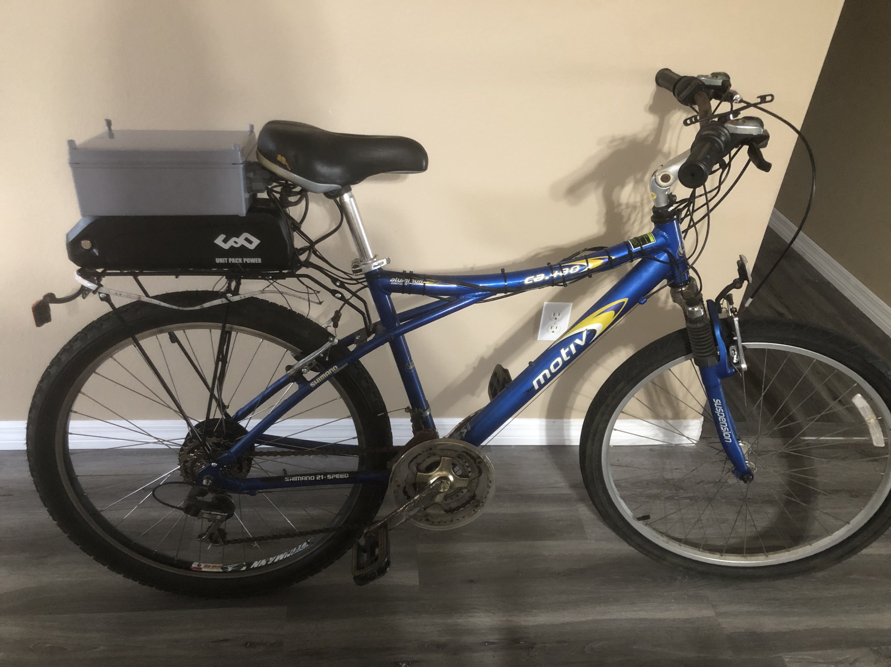
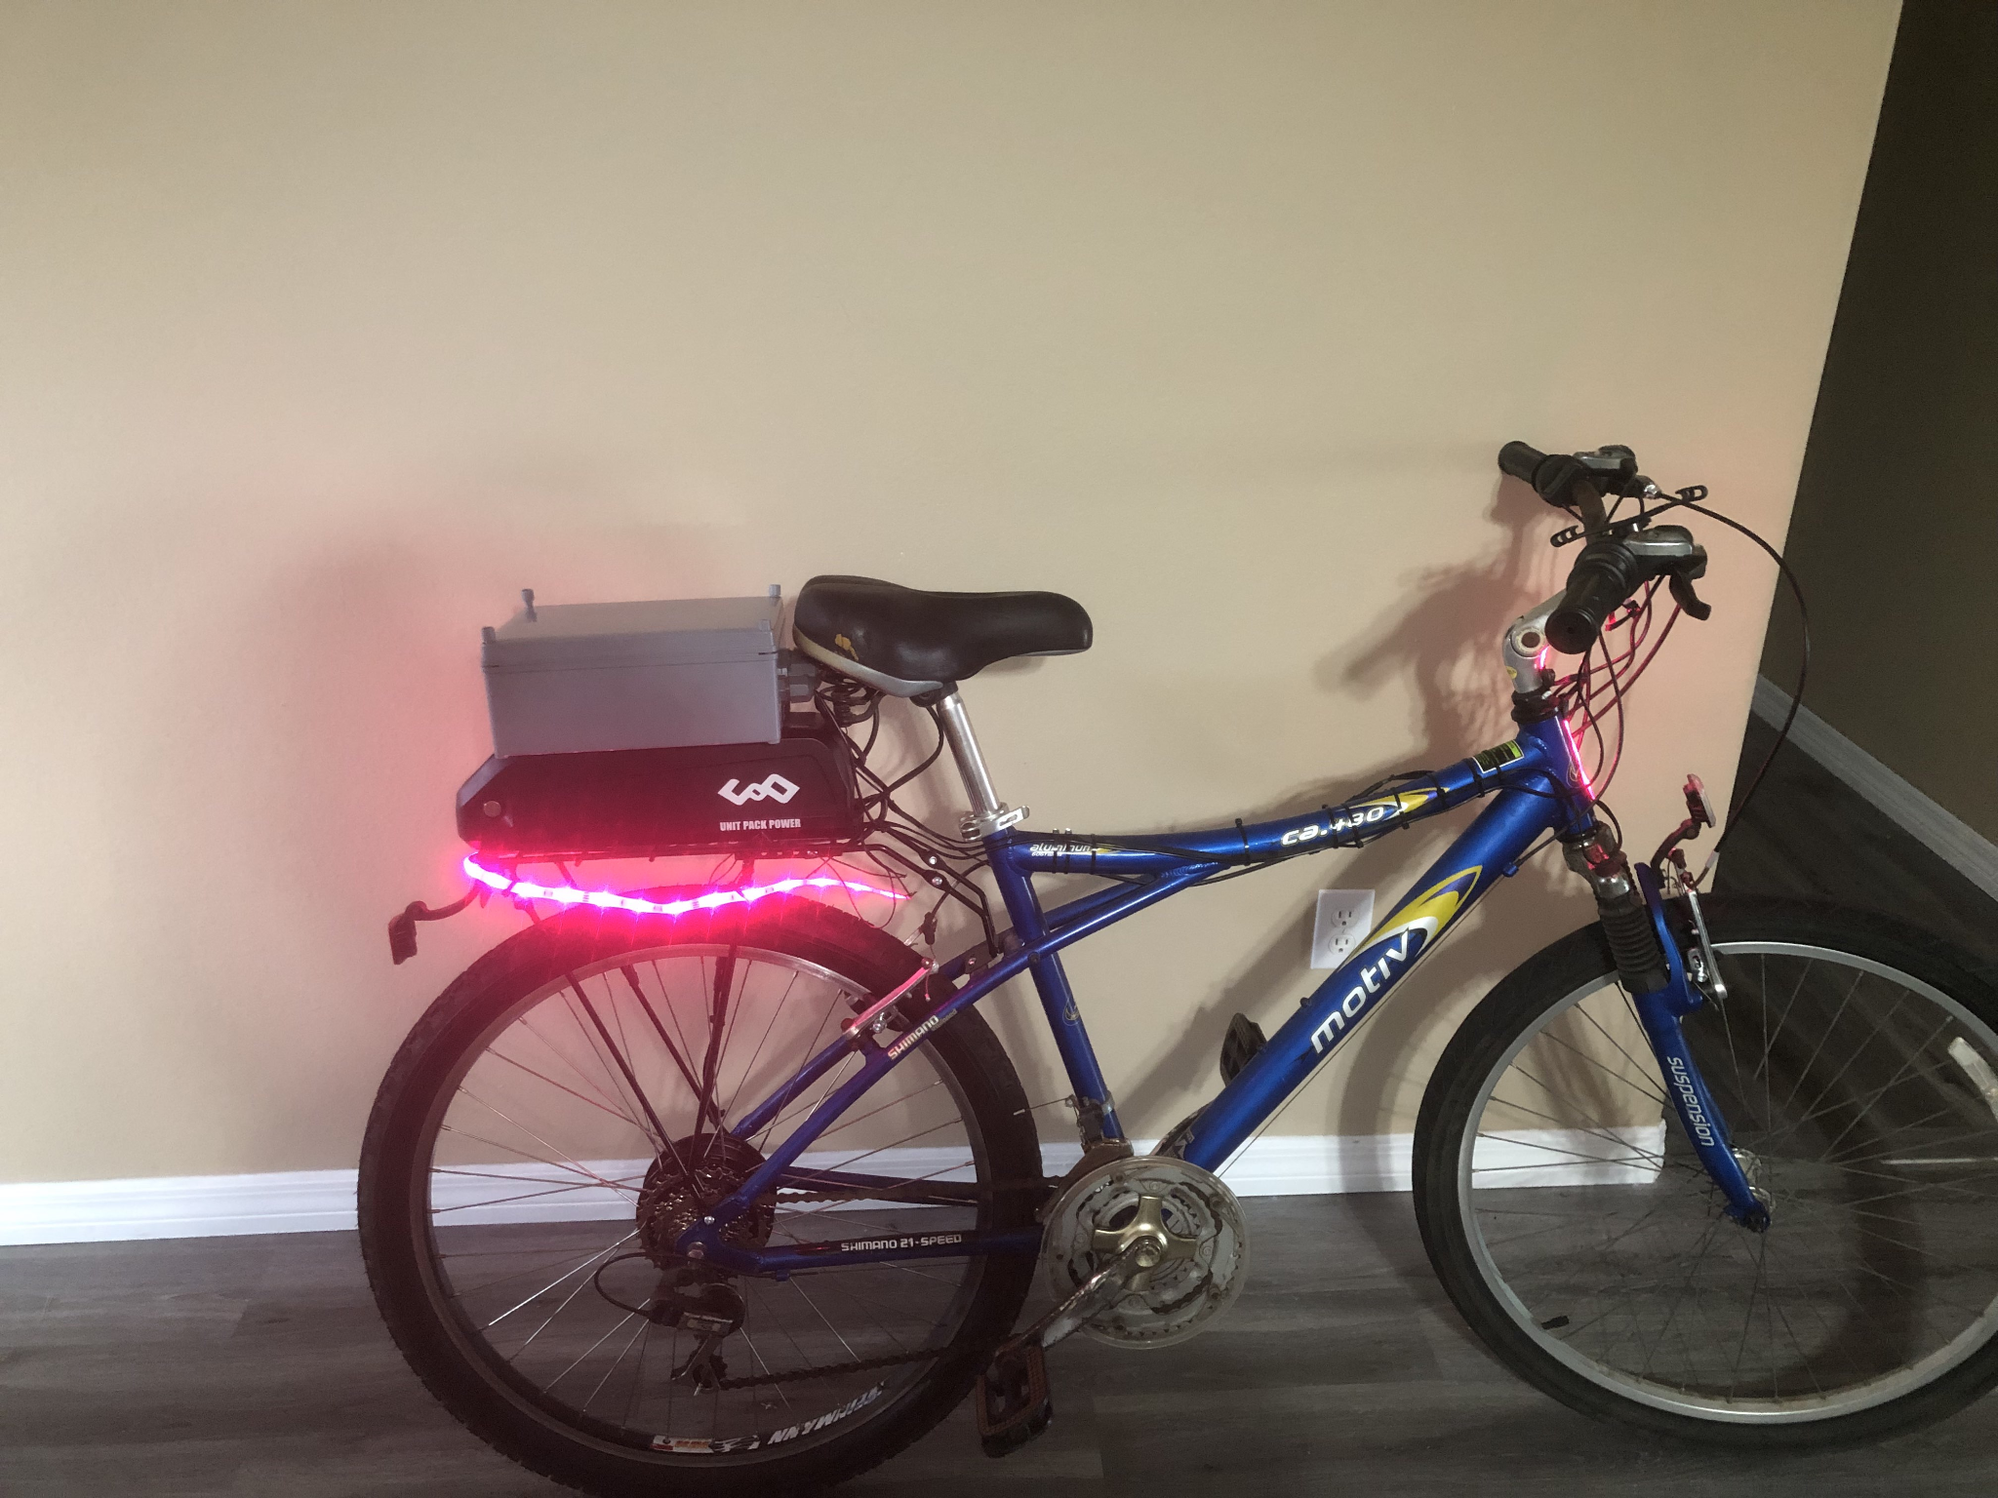
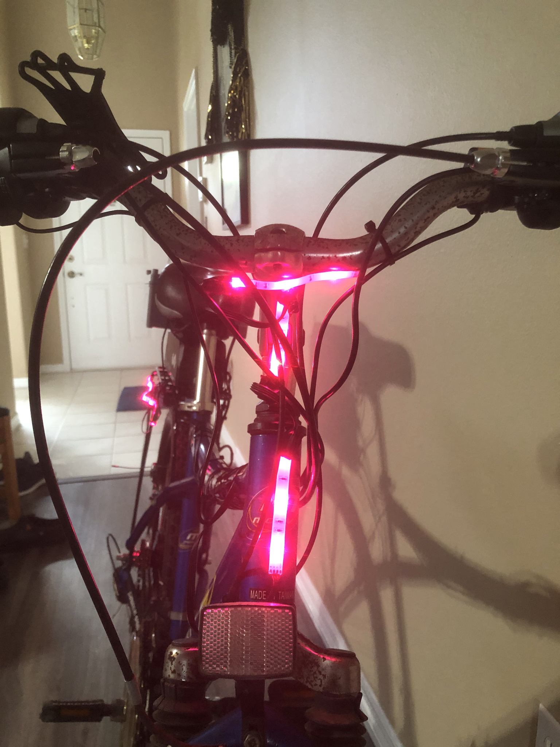
Final Design

Slide 34
Challenges: Hardware
Problem | Solution
Learning New Skills | Gaining more experience through practicing
Assembly | Find better options to accommodate the components
PCB Design | Trial and error in finding any issues
Notes:
Learning new skills like the reflow oven
We overcame solder installation problems though pushing and not giving up
PCB had issues such as footprints that were not readily available and had to be made ourselves and fixed in later iterations. We also had issues with ensuring that the correct part was bought and that was overcome by cross checking datasheets from digikey or mouser with the footprint on EasyEDA

Slide 35
Challenges: Software
Problem | Solution
Learning Flutter’s Dart Language | Exposure and practice helped with required knowledge
Bluetooth Communication; BLE devices only transmit 20 bytes at a time | Separate custom packets into sections
Bluetooth Communication; MCU receives one byte only | Byte encoding using masking; different bits provide different information
Application’s Bluetooth not receiving | Using incorrect device ID; tx-ing uses 128-byte id, rx-ing uses 16-byte id

Slide 36
Thank You!
Notes:
Cuts to make:
after chris and carlos’s first sections
After victors first slide (and around there)
After lights (around there)
First schematic
Second schematic
After pcb
A bunch on chris’s app section
End for software challs and thank you

